Slide 1
Design and Simulation of an AI-Driven Extended Detection and Response (XDR) System
Thesis Defense

Slide 2
Presentation Contents
(1) Slides 3-4 | Stated Problem & Research Questions
(2) Slide 5-6 | Literature Review – Results of Research
(3) Slides 7-8 | Proposed Methodology & System Architecture
(4) Slide 9 | Experimental Work
(5) Slide 10 | Results achieved & Hypotheses proven
(6) Slide 11 | Contribution to Research & Conclusions
(7) Slide 12- 15 | Final Implementation (Implemented web-app interface snapshots)

Slide 3
1. Introduction & Research Questions
Problems found in existing advancements & research:
Cyber attacks are becoming more and more complex to defend
SIEM and EDR systems rely mostly on standard set of rules for detection
Most modern cybersecurity systems still require heavy human input

Slide 4
1. Introduction & Research Questions *
Posed Research Questions
Can an Artificial Intelligence-driven XDR System accurately identify suspicious logs or events using a centralized telemetry system along with continuous log monitoring and analysis?
How much can Machine Learning algorithms improve threat detection, event correlation and risk mitigation?
Is it possible to simulate an almost fully automated incident response mechanism with an AI + ML Engine, while maintaining the level of reliability and accuracy that normal XDR solutions offer?
How effective is intrusion detection and event correlation in early mitigation of sequential or multi-scale attacks?

Slide 5
2. Literature Review – Research Gap
Existing cybersecurity systems (SIEM, EDR, SOAR) have specialized functionalities, but innovation is scarce and will prove to be a major issue with the evolvement of AI
Taking AI & ML separately without integrating it with a larger system doesn’t benefit the user or the model itself, making it capable of handling only specific cases
Existing research focuses primarily on individual tools that offer limited functionality, as AI is still a field in development

Slide 6
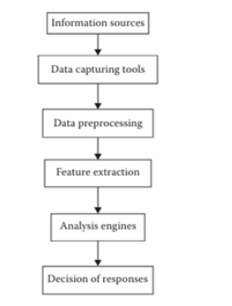
Schematic View of an Adaptive Defense System
(Included in thesis and referenced)

Slide 7
3. Methodology & Architecture
Literature Review
Research existing methodologies
System Design
Design proposed XDR system improving on identified flaws
Methodology Used
Implementation
Implement proposed solution
Testing
Testing and evaluation of proposed system

Slide 8
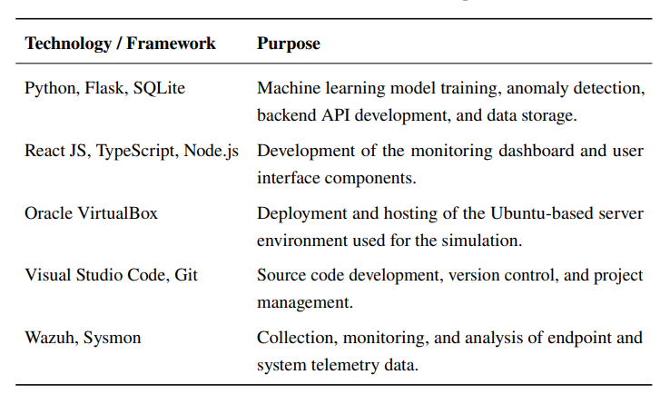
3. Methodology & Architecture *
Architecture
Technologies used are chosen based on the needs of this solution as well as the compatibility and ease of integration between them
(Included in thesis)

Slide 9
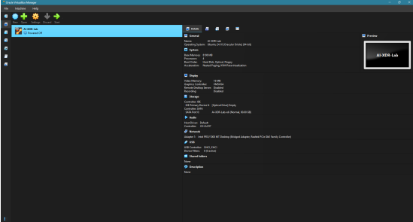
4. Experimental Work
- Unified Solution - Great focus to the machines - System is fully accessible via web - Everything is recorded in a database
(Included in thesis)

Slide 10
5. Results & Hypotheses
Hypothesis | Results
H1 - An Artificial Intelligence-driven XDR system can identify suspicious logs and security events through telemetry collection, continuous monitoring and automated AI-driven analysis with a good accuracy level | Supported in this simulated solution
H2 - The integration of Machine Learning algorithms greatly improves the effectiveness of an XDR solution compared to current systems that mostly use rule-based mechanisms | Supported in this simulated solution
H3 - Event correlation and Intrusion Detection (ID) can identify threats that launch large scaled attacks throughout the whole network, affecting all devices. | Not fully supported

Slide 11
6 - Final Conclusions & Contributions
1. Designed a complete AI-driven XDR solution
2. Integrated specific components such as Wazuh & Sysmon and ML in a single solution
3. Combined unsupervised and supervised learning methods to capture a better detection result
4. System is fully accessible via a web interface

Slide 12
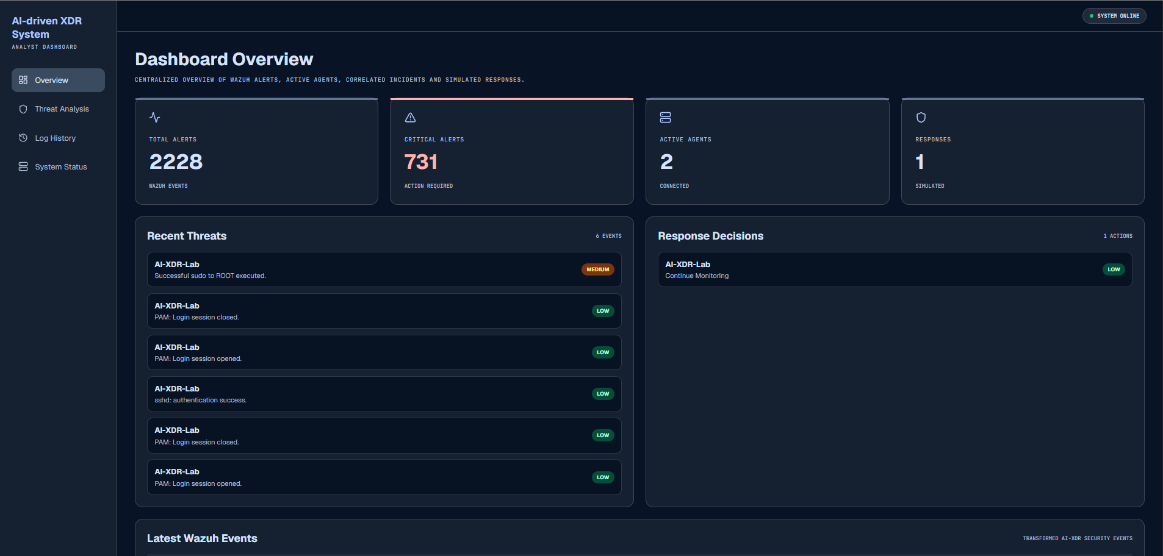
7. Final Implementation (Photos) [1]
Alert Stats
Simulated Responses
Recently recorded threats
(All snapshots are recorded and further explained in the document)

Slide 13
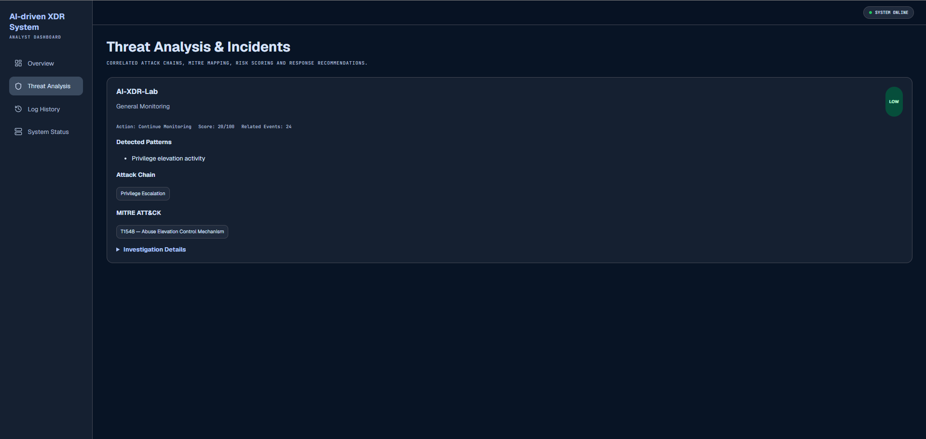
7. Final Implementation [2]
Correlation engine findings

Slide 14
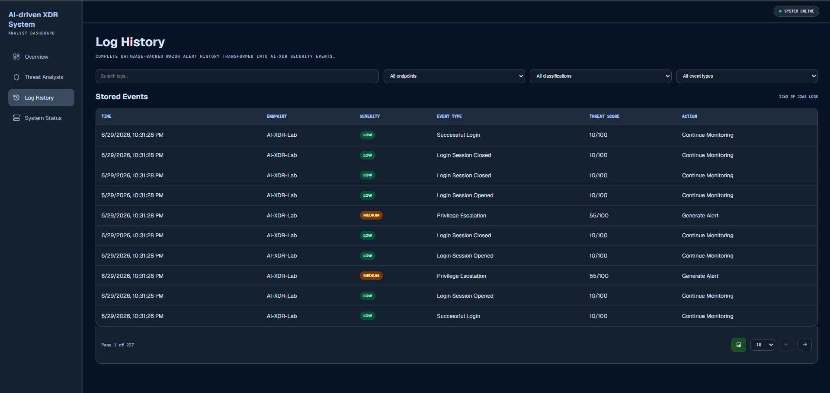
7. Final Implementation [3]
Export button for further analysis
Overview of all generated logs divided by origin and severity

Slide 15
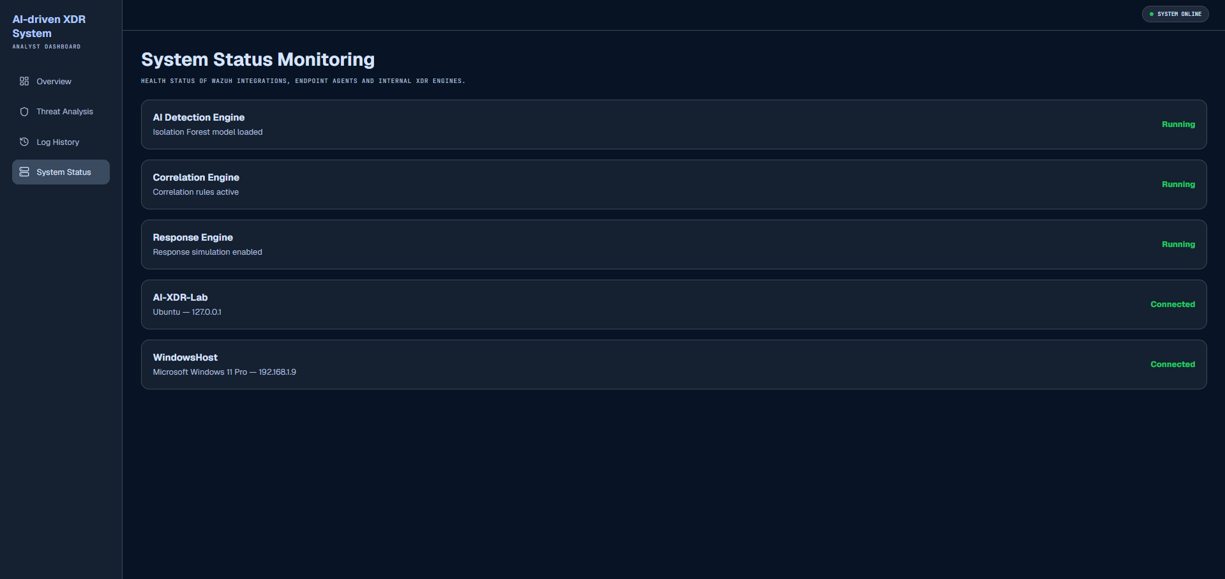
7. Final Implementation [4]
Monitoring system for all running agents and services related to the application

Slide 16
Thanks!!
Do you have any questions?
Please keep this slide as attribution

